Slide 1

Sheltered Instruction
WS# 71133
Karina E. Chapa, M.Ed.
Language Proficiency, Biliteracy and Cultural Diversity Director
kchapa@esc1.net
Twitter @esc1bilingual @bilingualpride

Slide 2

Professional Learning Essential Agreements
Be respectful of others
Be an active participant
Take care of your needs
Use electronic devices as learning tools
©2018 Region One Education Service Center

Slide 3

Keeping It Together
Sheltered Instruction

Slide 4
Session Objectives
Content Objective
Language Objective
Today I will explore sheltered instruction techniques and strategies to make content comprehensible for my ELLs.
Today I will share different ideas on how to implement sheltered instruction strategies in the classroom.

Slide 5
Three-Step Interview
Stand up when you can complete one of these sentences:
  Teaching ELLs is so difficult because…
  One challenge I face when teaching ELLs is…
  One challenge I face when instructing ELLs is… What I have done to overcome this challenge is…
Beginner
Intermediate
Advanced

Slide 6
What are the two goals of Sheltered Instruction?
Make Content Comprehensible
Develop Academic Language

Slide 7
TELPAS-ELPS
Connection

Slide 8
Keeping It Together
Sheltered Instruction
TELPAS-ELPS Connection

Slide 9
ELPS: How are they organized?
Big Ideas
1. Make Content Comprehensible
2. Develop Academic Language
Big Responsibilities
1. Communicated
2. Sequenced
3. Scaffolded
Student Expectations
1. Listening
2. Speaking
3. Reading
4. Writing
5. Learning Strategies
PLDs (L, S, R, W)
1. Beginning
2. Intermediate
3. Advanced
4. Advanced High
©2018 Region One Education Service Center

Slide 10
TEKS vs ELPS
STAAR
TELPAS
T
E
K
S
E
L
P
S

Slide 11
TEKS vs ELPS
Academic Proficiency Language Proficiency
STAAR
TELPAS
TEKS
ELPS
Relating Factor: evaluates/measures

Slide 12
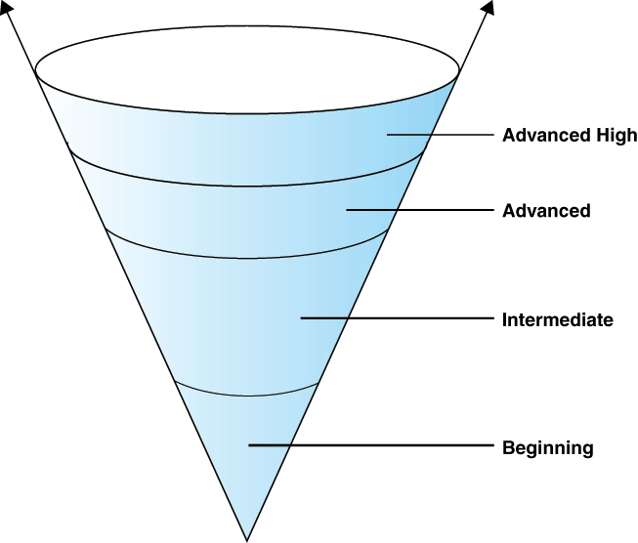
TELPAS Levels

Slide 13
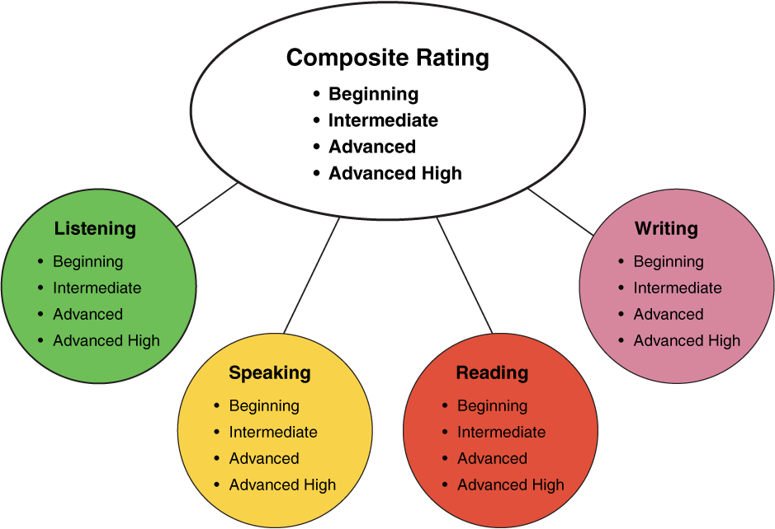
TELPAS Domains
10%
30%
10%
50%
Online for 2nd-12th

Slide 14
DMAC TELPAS Reports
How to Run TELPAS Reports by Language Domain
Go to Home Page
Go to State Assessment
Select TELPAS
Select Instructional Reports
Select Student Language Proficiency Rating
Generate Report

Slide 15

Sample DMAC Report

Slide 16
Content and language objectives

Slide 17
Keeping It Together
Sheltered Instruction
TELPAS-ELPS Connection
Content and Language Objectives

Slide 18

Anticipation Guide
kahoot.it
create.kahoot.it
Let’s Kahoot!
Notes:
To run the kahoot, create a kahoot account at create.kahoot.it and on the search field type “kchapa”. You will see several kahoots listed. Just select “Content and Language Objectives” and play it! Have fun!

Slide 19
Round Table
Divide a piece of paper in two sections
Create a T chart
Write everything you know about content and language objectives
15 seconds!
Pass your paper to your right!
Repeat!
Content Objectives
Language Objectives
Let’s Write!

Slide 20
The What and the How
Content Objectives come from the TEKS
What am I going to learn?
Language Objectives come from the ELPS
How will I demonstrate my learning through listening, speaking, reading and/or writing?
Content and Language Objectives

Slide 21
Content Objective - Sample
Science TEKS: Differentiate between structure and function in plant and animal cell organelles including cell membrane, cell wall, nucleus, cytoplasm, mitochondria, chloroplast and vacuole.
STUDENT FRIENDLY CONTENT OBJECTIVE
Today I will compare and contrast the cell structures and functions of plants and animals.

Slide 22
Writing Content Objectives
Pair-up
Analyze a Student Expectation (TEKS) from any content area
Write it in a student-friendly format
You have 2 minutes
Write it on the top of a chart paper
Today I will…

Slide 23
Science TEKS: Differentiate between structure and function in plant and animal cell organelles including cell membrane, cell wall, nucleus, cytoplasm, mitochondria, chloroplast and vacuole.
CONTENT OBJECTIVE
Today I will compare and contrast the cell structures and functions of plants and animals.
LANGUAGE OBJECTIVE
©2018 Region One Education Service Center

Slide 24
Language Objective - Sample
Content Objective:
Today I will compare and contrast the cell structures and functions of plants and animals.
Language Objective:
Today I will write an essay comparing and contrasting plant and animal cells utilizing transitional phrases.

Slide 25
Writing Language Objectives
Pair-up
Look back at the content objective you wrote
Write a language objective in a student-friendly format
You have 2 minutes
Write it on the chart paper below the content objective
Today I will…

Slide 26
Science TEKS: Differentiate between structure and function in plant and animal cell organelles including cell membrane, cell wall, nucleus, cytoplasm, mitochondria, chloroplast and vacuole.
CONTENT OBJECTIVE
Today I will compare and contrast the cell structures and functions of plants and animals.
LANGUAGE OBJECTIVE
Today I will write an essay comparing and contrasting plant and animal cells utilizing transitional phrases.
©2018 Region One Education Service Center

Slide 27
Key Points to Remember
Make objectives student friendly and appropriate for grade level
Objectives are for students, not for the adults in the classroom
Post eye level
Review with students before, during and after each lesson

Slide 28
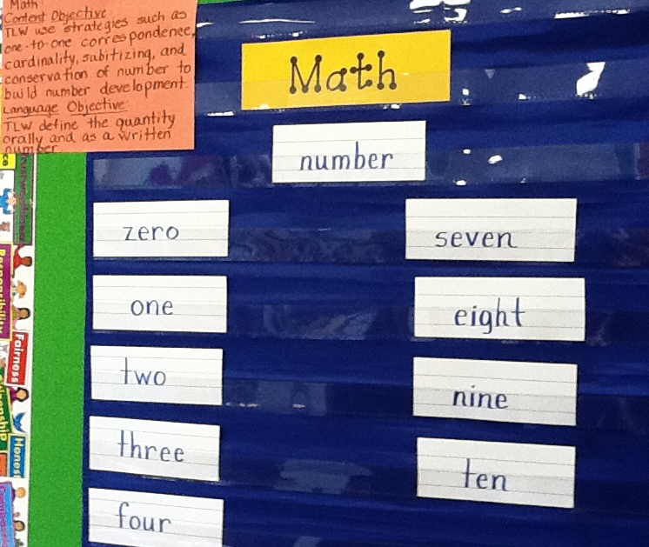
Provide Feedback
Content and Language Objectives

Slide 29
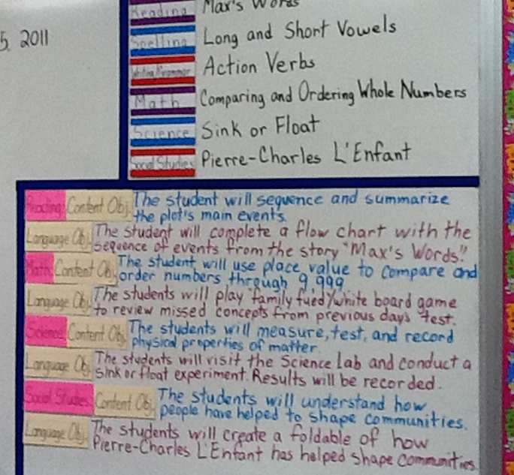
Provide Feedback
Content and Language Objectives

Slide 30
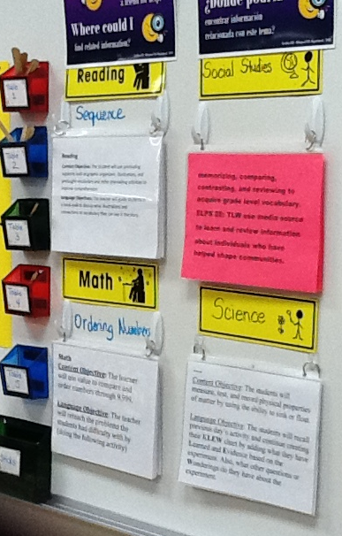
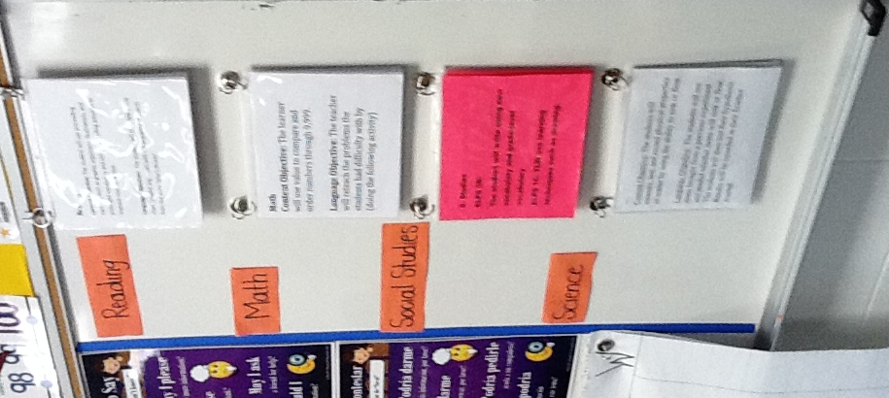
Provide Feedback

Slide 31
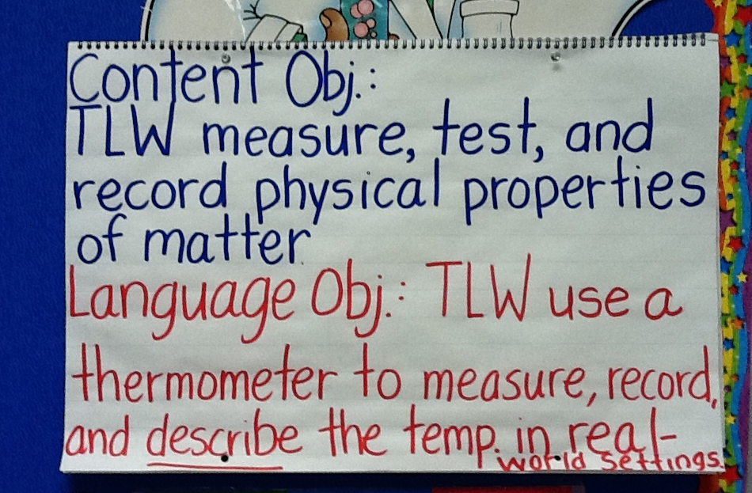
Provide Feedback

Slide 32
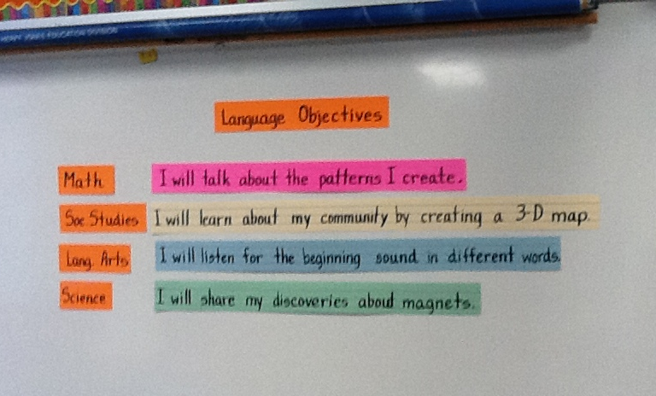
Provide Feedback

Slide 33
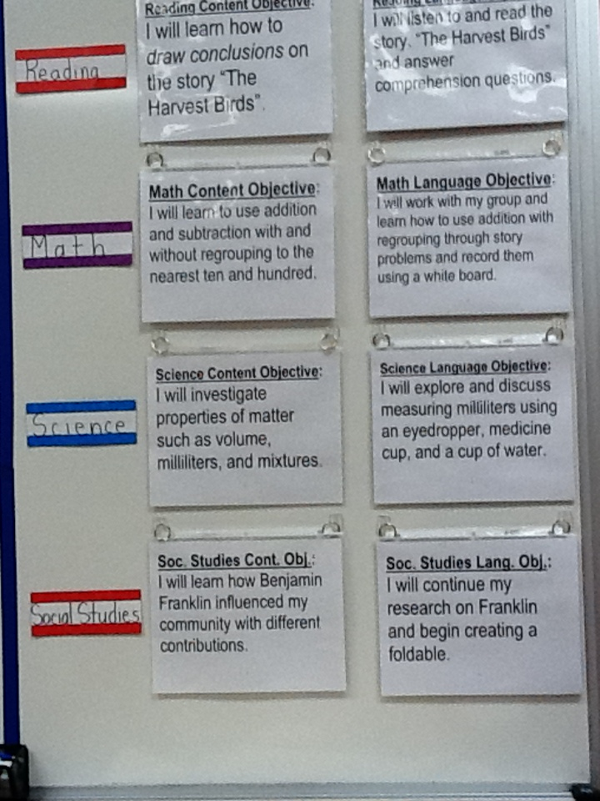
Provide Feedback
Content and Language Objectives

Slide 34
The power of Cognates

Slide 35
Keeping It Together
Sheltered Instruction
TELPAS-ELPS
Content and Language Objectives
The Power of Cognates

Slide 36
The Power of Cognates
La chimica è la scienza che studia la composizione della materia ed il suo comportamento in base a tale composizione.

Slide 37
The Power of Cognates
La chimica è la scienza che studia la composizione della materia ed il suo comportamento in base a tale composizione.

Slide 38

Your Turn!
1. Individually make a list of 5 academic words from any content area.
2. Turn to your partner and combine your two lists of words (even if from different content areas).
3. Find another pair and exchange your lists.
4. Write the Spanish cognates next to each academic word. Use Google Translate if needed.
5. Calculate what percentage of the words are cognates.
1 – 2 – 4 – ALL
http://www.realfastspanish.com/vocabulary/spanish-cognates

Slide 39
Speaking in complete sentences

Slide 40
Keeping It Together
Sheltered Instruction
TELPAS-ELPS Connection
Content and Language Objectives
The Power of Cognates
Speaking in Complete Sentences

Slide 41
1-2-4-ALL
Why is it important to encourage English Learners to speak in complete sentences?
Write your individual answer on a piece of paper.
Share with a partner and add any new ideas to your paper.
Now share with another pair your answers and keep adding new ideas to your own papers.
As a whole table come up with a final complete answer.

Slide 42
Use of Complete Sentences
Does this mean that students need to answer in complete sentences all the time?
TIP:
Provide students with sentence frames and sentence starters if they are struggling to produce complete thoughts in English.

Slide 43
Use of Complete Sentences
  1. When reviewing a handout or worksheet
    Non-Example
    Teacher: How much is 5 X 4?
    Student: 20!
    Example
    Teacher: What is the product of 5 X 4?
    Student: The product of 5 and 4 is 20

Slide 44
Use of Complete Sentences
  2. When students are given sentence starters
    Non-Example
    Teacher: Who is your favorite character and why?
    Student: Esperanza!
    Example
    Teacher: Who is your favorite character and why? Please complete the following sentence: “My favorite character is… because…”
    Student: My favorite character is Esperanza, because she was very brave.

Slide 45
Your Turn! Gallery Walk!
Using the Content and Language Objectives that you developed, write 2 questions and 2 sentence stems that your students might be able to answer throughout the lesson.
Write them on post-its and place them on your chart paper.

Slide 46
RANDOMIZATION TECHNIQUES

Slide 47
Keeping It Together
Sheltered Instruction
TELPAS-ELPS Connection
Content and Language Objectives
The Power of Cognates
Speaking in Complete Sentences
Randomization Techniques

Slide 48

Make an Appointment
©2018 Region One Education Service Center

Slide 49
Randomization Techniques
Write-Read-Read-Trade
Stand up when you complete in writing one of these sentences:
  I select who I call on by…
  In my classroom, I include randomization because…
  The most beneficial randomization technique I have used is… because…
  Please write your answer in two different post-its.
  Conga Line Time!

Slide 50
Randomization Techniques
Is it possible to randomize and differentiate instruction at the same time?
Randomize and rotate who is called on,
so students of all language levels can participate!

Slide 51
Randomization Techniques
Lucky sticks
Beach ball
Index cards
with student names
Class list/roster
Color/numbers
Birthdays
Physical characteristics: longest hair, eye color…
Jenga
Pick up sticks
Career cards
Apps
Popcorn

Slide 52
Total response signals

Slide 53
Keeping It Together
Sheltered Instruction
TELPAS-ELPS Connection
Content and Language Objectives
The Power of Cognates
Speaking in Complete Sentences
Randomization Techniques
Total Response Signals

Slide 54
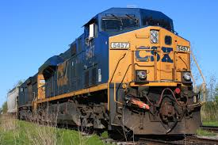
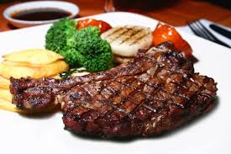
Why is it important to check for understanding along the way?

Slide 55
Written Responses
Hold up paper
White boards
Ready Responses
Hands up when ready
Personal Chalkboards
Answers on cards
Thinker’s chin
Stand up when ready
Put your pen on your paper when ready
All eyes on teacher
Making Choices
Open hand/closed hand
Ranking
Rank with your fingers
Thumbs/Pens up/down
Number wheels
Green card/red card
Move to the corner/spot
Rank with your arm
Line up according to response
Knocking/clapping/
cheering

Slide 56
Find the Fib!
Students may work in pairs or small groups.
Students have an index card with the numbers “1, 2, 3, 4” on one side and “A, B, C, D” on the other side of the card.
Teacher writes 3 statements on the board (one false, two true) and students decide which one is the fib.
On signal from teacher, students show the number of the statement they believe is the fib.

Slide 57
Let’s Play!
Find the Fib
Evaporation is part of the water cycle
Refraction is part of the water cycle
Condensation is part of the water cycle
      I believe number… is a fib because…

Slide 58
Let’s Play!
Find the Correct Answer
Rhea is a moon of Saturn. Which of these facts about Rhea best indicates that it does not have a water cycle in which water changes state?
A Its radius is 765 km.
B Its density is about 1.3 kg/m3.
C Its period of rotation is about 4.5 Earth days.
D Its temperature is between −174°C and −220°C.

Slide 59
Developing academic vocabulary

Slide 60
Keeping It Together
Sheltered Instruction
TELPAS-ELPS Connection
Content and Language Objectives
The Power of Cognates
Speaking in Complete Sentences
Randomization Techniques
Total Response Signals
Developing Academic Vocabulary

Slide 61
1. When you can complete this sentence in your mind, please stand up.
Academic vocabulary development is important for ALL students, but especially for ELLs, because…
2. Find your 9 o’clock appointment and share your responses.

Slide 62
What does this mean?
Carving is appropriate for most green and blue slopes and even some black slopes. However, if you try to carve through moguls, especially in packed powder or corn snow, you’re going to face-plant.

Slide 63
What does this mean?
Carving is appropriate for most green and blue slopes and even some black slopes. However, if you try to carve through moguls, especially in packed powder or corn snow, you’re going to face-plant.

Slide 64
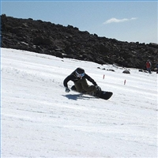
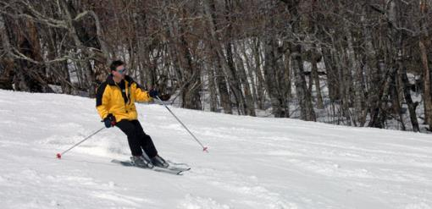
Would this help?
These men are carving.

Slide 65
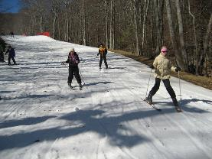
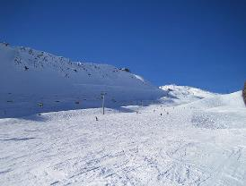
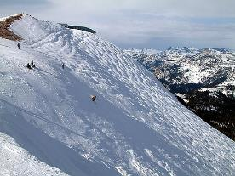
How about this?
Green Slope
Blue Slope
Black Slope

Slide 66
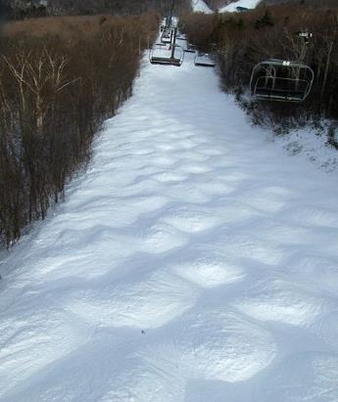
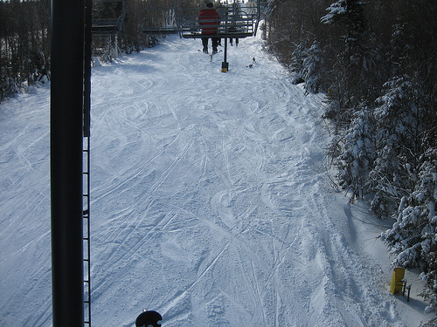
Moguls Packed Powder

Slide 67
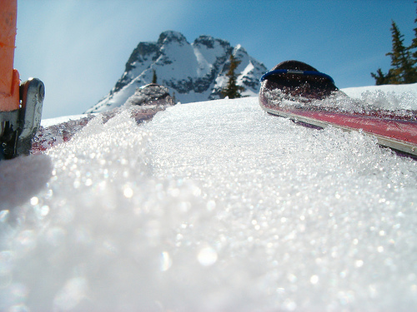
Corn Snow

Slide 68
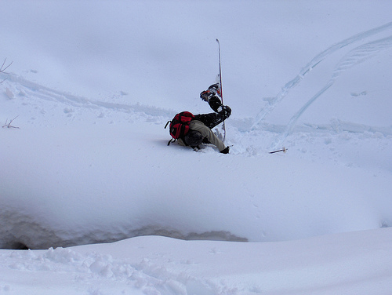
Face-plant

Slide 69
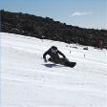








Carving is appropriate for most green and blue slopes
and even some black slopes. However, if you try to carve
through moguls, especially in packed powder or corn snow
you’re going to face-plant.
apropiado
especialmente

Slide 70
Session Objectives
Content Objective
Language Objective
Today I explored sheltered instruction techniques and strategies to make content comprehensible for my ELLs.
Today I shared different ideas on how to implement sheltered instruction strategies in my classroom.

Slide 71

Exit Tickets
Go to:
https://tinyurl.com/SIRISE1
I used to think…
But now I know…

Slide 72
Thank you for your participation!
Karina E. Chapa, M.Ed.
Language Proficiency, Biliteracy and Cultural Diversity Director
Center for Excellence in Education of Diverse Students (CEEDS)
kchapa@esc1.net
Facebook: Region One ESC Bilingual
Twitter @esc1bilingual @bilingualpride

